Slide 1

Library Management System (SQL Project) by Ashok T
This project presents a normalized relational database design for a multi-branch library system, implemented with SQL and illustrated with sample analytical queries. The deck guides you from objectives through data modeling and practical queries.

Slide 2

Introduction
Libraries store diverse data about books, authors, borrowers, loans, and branches. Manual or spreadsheet-based management causes inefficiency, duplicated records, and integrity problems. A relational database enforces structure, constraints, and relationships so librarians can reliably find and manage resources.
This presentation explains the design decisions and demonstrates key SQL queries for common operational and analytical tasks.

Slide 3

Objective
Primary goals:
Design an intuitive relational schema for library operations across multiple branches.
Enforce data integrity using keys and constraints (PKs, FKs, unique constraints).
Support efficient tracking of books, individual copies, loans, and borrowers.
Provide example SQL queries that demonstrate real-world reporting and investigation.

Slide 4

Problem Statement
Many libraries experience redundancy (duplicate book/author records), inconsistent borrower information, and difficulties tracking individual copies across branches. The goal is to replace ad-hoc systems with a unified relational database that:
1) eliminates redundancy via normalization,
2) defines clear relationships between entities, and
3) enables automation of loan management and reporting to reduce human error.

Slide 5





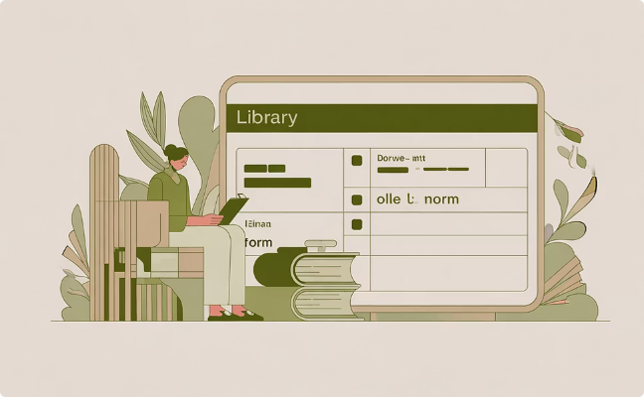

Overview of Data
tbl_book.csv
tbl_publisher.csv
tbl_book_authors.csv
tbl_library_branch.csv
Primary book metadata: BookID (PK), Title, ISBN, PublisherID, PublicationYear, Category.
Publisher details: PublisherID (PK), Name, Address, Contact.
Author association table: BookAuthorID (PK), BookID (FK), AuthorName — supports many-to-many if modeled further.
Branches: BranchID (PK), BranchName, Location, ContactInfo.
tbl_book_copies.csv
tbl_borrower.csv
tbl_book_loans.csv
Copies: CopyID or composite (BookID, BranchID), No_Of_Copies — tracks how many physical copies each branch holds.
Borrowers: CardNo (PK), BorrowerName, Address, Phone, Email — unique card numbers identify patrons.
Loans: LoanID (PK), BookID (FK), BranchID (FK), CardNo (FK), DateOut, DueDate, DateIn — core for circulation tracking.

Slide 6


Data Model Diagram
Publisher
Copies
Book
Author
The diagram clarifies cardinality and where foreign keys enforce relationships. Normalization reduces duplicated publisher and author data; copies are tied to both Book and Branch to represent inventory per branch.

Slide 7
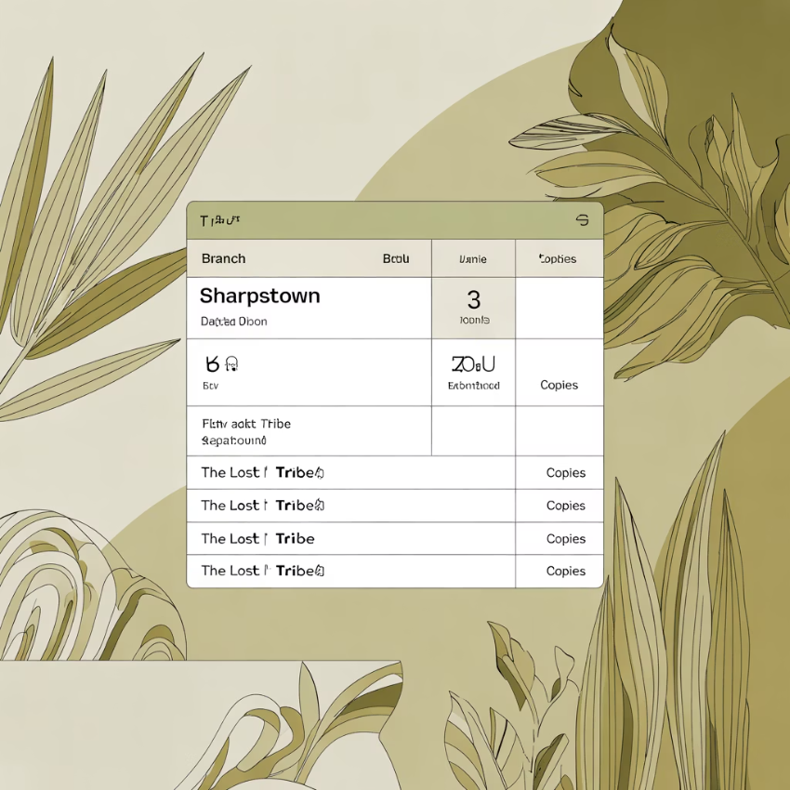
Query 1 — Book Copies at Sharpstown
This query finds how many copies of the title "The Lost Tribe" are available specifically at the Sharpstown branch. It joins copies with books and branches to constrain results by title and branch name. Use this to answer circulation and stocking questions for branch-level procurement.
SELECT lb.library_branch_BranchName, b.book_Title, bc.book_copies_No_Of_CopiesFROM tbl_book_copies bcJOIN tbl_book b ON bc.book_copies_BookID = b.book_BookIDJOIN tbl_library_branch lb ON bc.book_copies_BranchID = lb.library_branch_BranchIDWHERE b.book_Title = 'The Lost Tribe' AND lb.library_branch_BranchName = 'Sharpstown';
Notes: Ensure Title matching handles case or whitespace; consider using b.book_Title ILIKE '%Lost Tribe%' for fuzzy matches in some RDBMS.

Slide 8

Query 2 — Book Copies per Branch
This query lists the number of copies of 'The Lost Tribe' across all branches. It supports inventory audits and redistribution planning. It aggregates per branch when multiple copy records exist per branch for the same book.
SELECT lb.library_branch_BranchName, b.book_Title, bc.book_copies_No_Of_CopiesFROM tbl_book_copies bcJOIN tbl_book b ON bc.book_copies_BookID = b.book_BookIDJOIN tbl_library_branch lb ON bc.book_copies_BranchID = lb.library_branch_BranchIDWHERE b.book_Title = 'The Lost Tribe';
Tip: For consolidated counts, wrap bc.book_copies_No_Of_Copies with SUM(...) and add GROUP BY lb.library_branch_BranchName, b.book_Title.

Slide 9

Query 3 — Borrowers Without Loans
Identify registered borrowers who currently have no active loans. This is useful for engagement campaigns and cleaning up stale borrower accounts. The LEFT JOIN/IS NULL pattern reliably finds rows in tbl_borrower without matching current loan records.
SELECT br.borrower_BorrowerName, br.borrower_CardNoFROM tbl_borrower brLEFT JOIN tbl_book_loans bl ON br.borrower_CardNo = bl.book_loans_CardNoWHERE bl.book_loans_CardNo IS NULL;
Consider filtering loans by DateIn IS NULL if table keeps historical loans—this ensures identification of borrowers with no currently checked-out books.

Slide 10

Query 4 — Due Books at Sharpstown
Retrieve all books due on 2018-03-02 at the Sharpstown branch, including borrower contact details for reminders or hold processing. This query joins loans to books, borrowers, and branches to produce actionable circulation tasks for staff.
SELECT b.book_Title, br.borrower_BorrowerName, br.borrower_BorrowerAddress, bl.book_loans_DueDateFROM tbl_book_loans blJOIN tbl_book b ON bl.book_loans_BookID = b.book_BookIDJOIN tbl_borrower br ON bl.book_loans_CardNo = br.borrower_CardNoJOIN tbl_library_branch lb ON bl.book_loans_BranchID = lb.library_branch_BranchIDWHERE lb.library_branch_BranchName = 'Sharpstown' AND bl.book_loans_DueDate = '2018-03-02';
Operational tips: Use this output to generate reminder emails/SMS. If multiple items per borrower exist, group results by borrower for consolidated notifications.

